Slide 1
Introduction to Databases and Access
Part 1

Slide 2
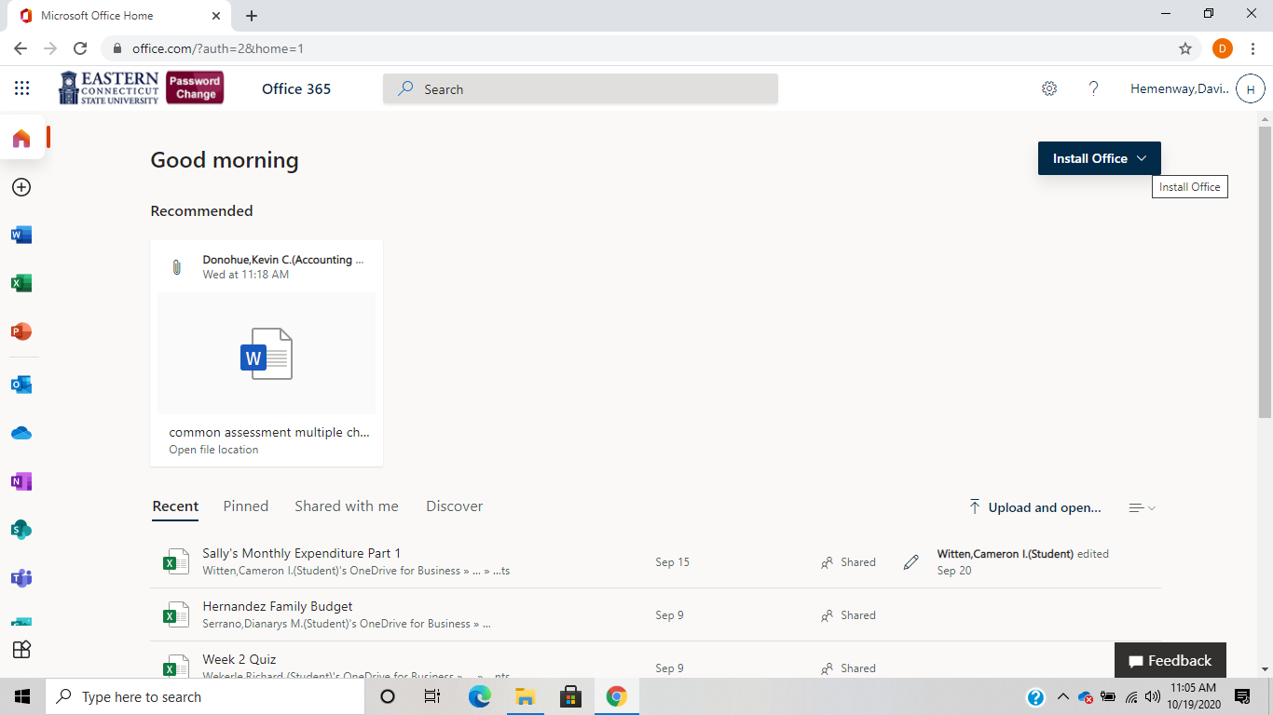
Where to get Office 365:

Slide 3
Introduction to Databases and Access
Basic Database Concepts/Terms
Using the Steps Spreadsheet as a Database

Slide 4
Basic Database Terms
Field
The basic unit of database tables
Holds one piece of data—first name, last name, street
The specific content of a field is called the field value
In the columns of a table
Record
A collection of all fields related to one case like all fields for a person or company
In the rows of a table
Table
A collection of related records stored together in a database.
There can be, and usually are, a number of tables in one database.

Slide 5
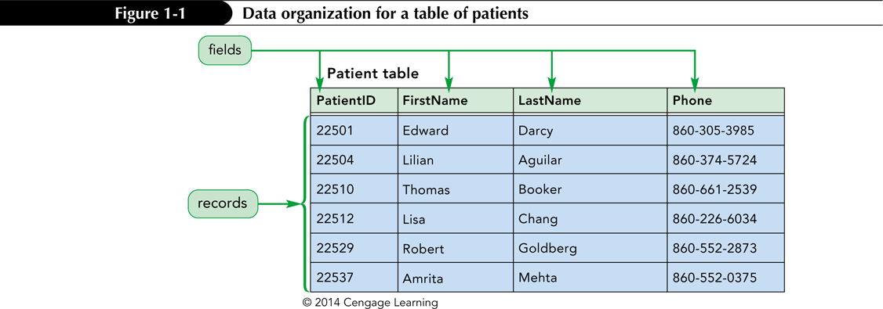

Slide 6
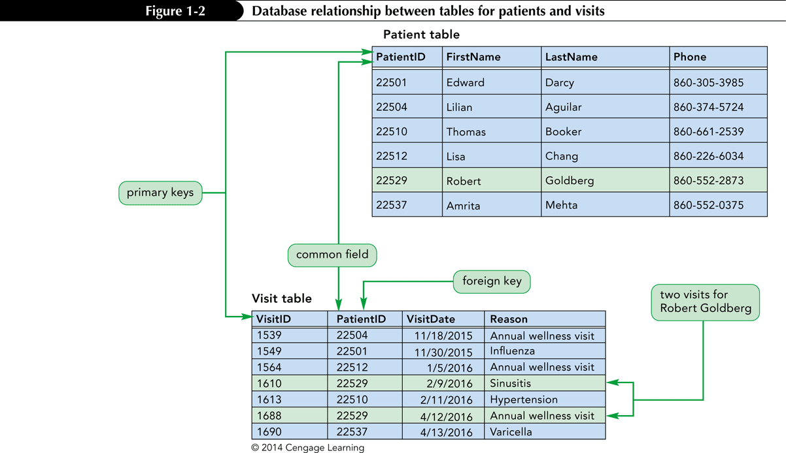
Databases and Relationships A relational database is a collection of related tables
Records in the separate tables are connected through a common field
A primary key is a field, or a collection of fields, that uniquely identify each record in a table
Including the primary key from one table as a field in a second table to form a relationship between the two tables, it is called a foreign key in the second table

Slide 7
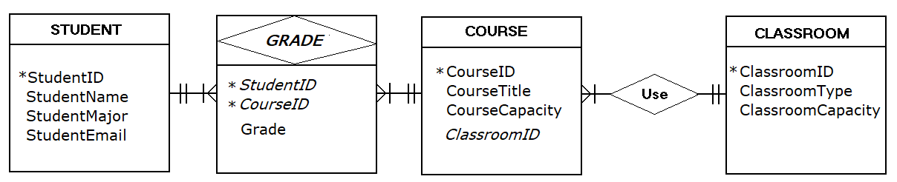
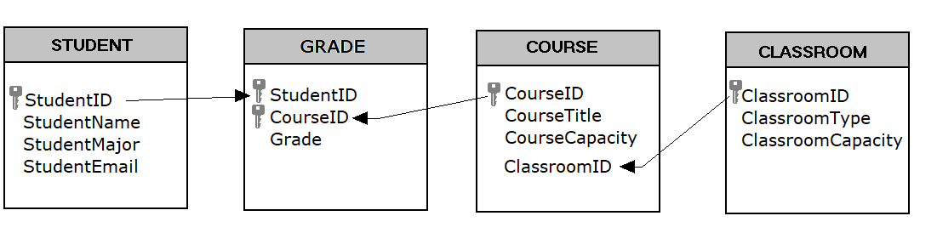
Relationships Between Data
Entity-Relationship (ER) diagrams are used for database design
The design viewed within the database

Slide 8
Relational Database Management Systems
A database management system (DBMS) is a software program that lets you create databases and then manipulate the data they contain
In a relational database management system, data is organized as a collection of tables. A relational DBMS controls the storage of databases and facilitates the creation manipulation, and reporting of data
Is Access a database management system (DBMS)?

Slide 9
A Relational DBMS Provides the Following Functions:
Allows you to create database structures containing fields, tables, and table relationships
Lets you easily add new records, change field values in existing records, and delete records
Contains a built-in query language (called SQL), which lets you obtain immediate answers to the questions (or queries) you ask about your data
Contains a built-in query/report generator, which lets you produce professional-looking, formatted reports from your data
Protects databases through security, control, and recovery facilities

Slide 10
Get the Supplier Item Database from Blackboard – Week 9

Slide 11
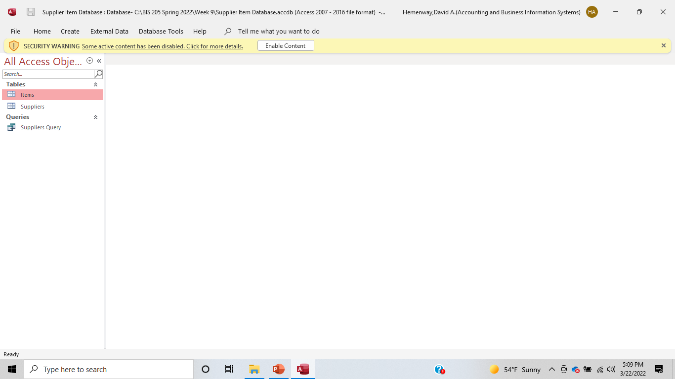

Slide 12
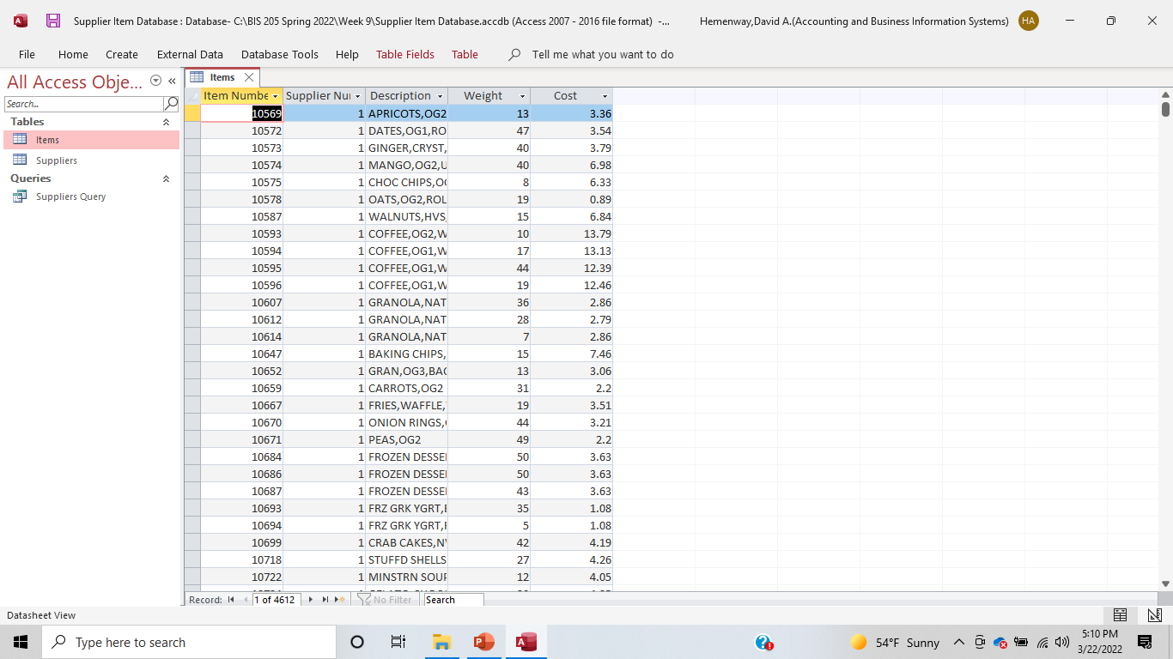

Slide 13
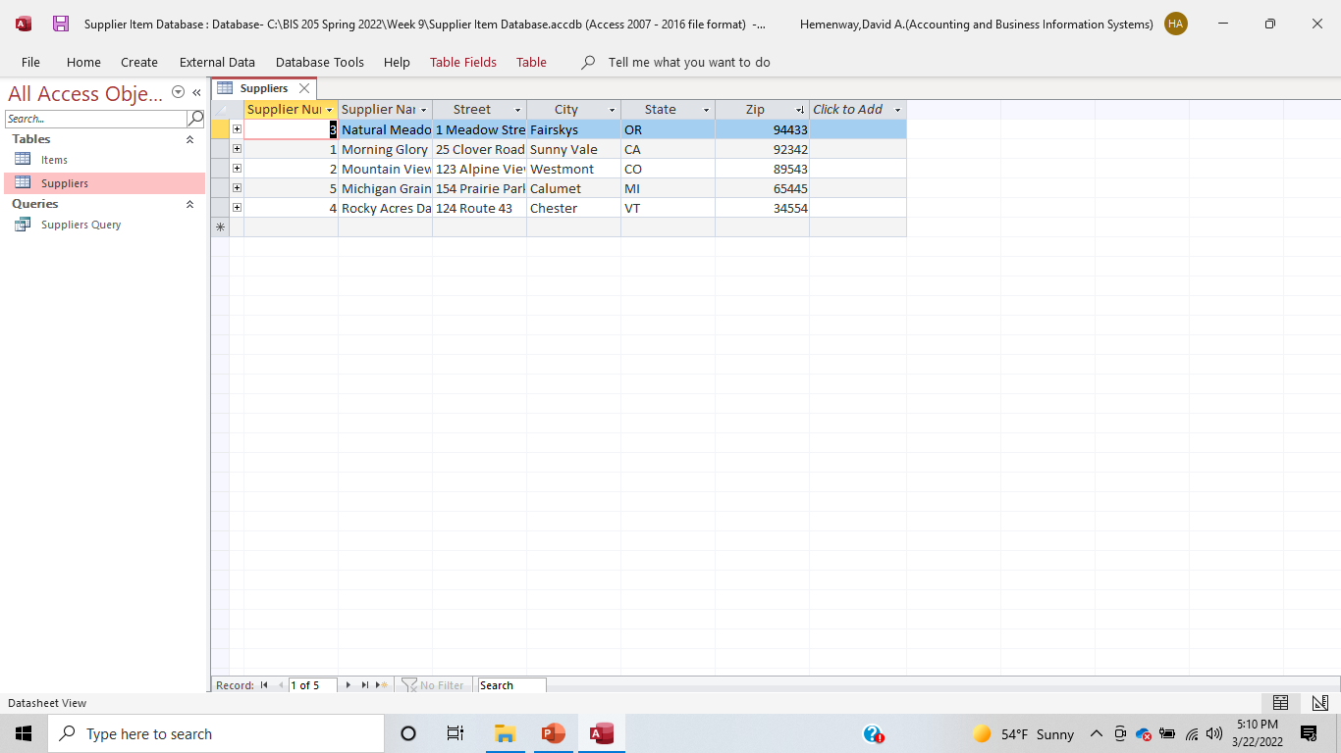

Slide 14
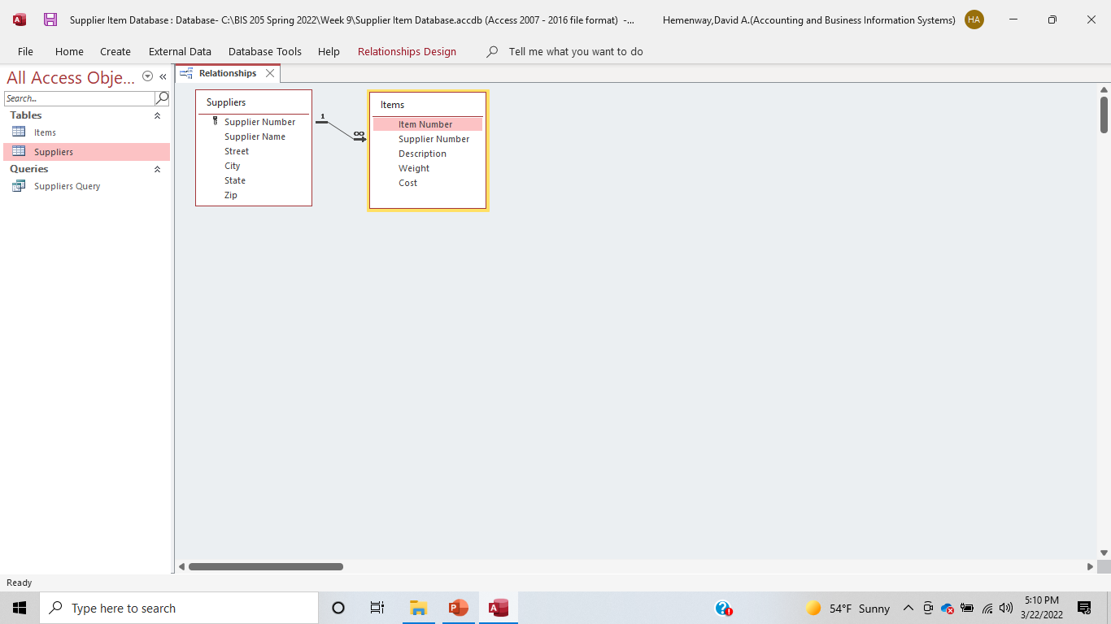

Slide 15
How many items are sold by each vendor?

Slide 16
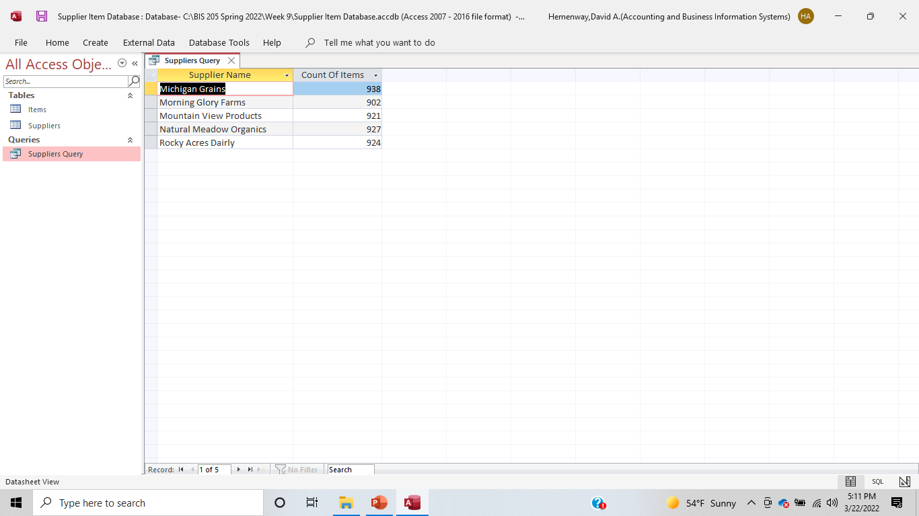

Slide 17
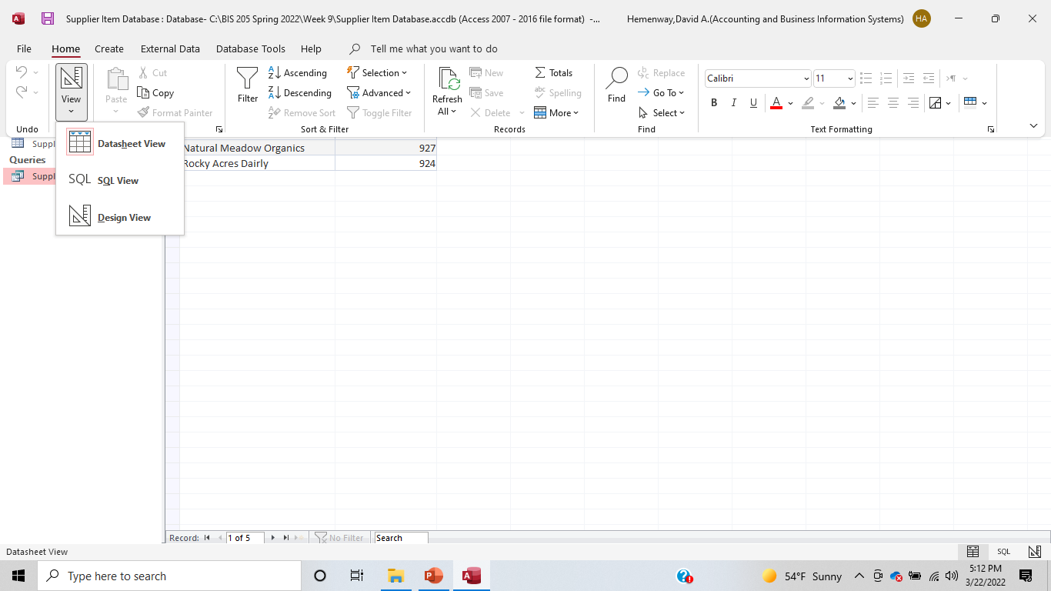

Slide 18
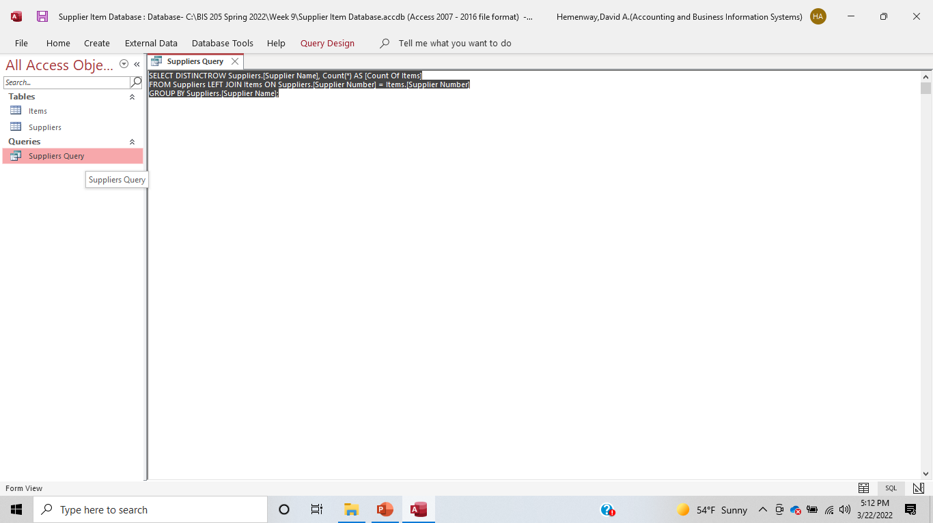

Slide 19
Play! You can’t break it!

